Slide 1
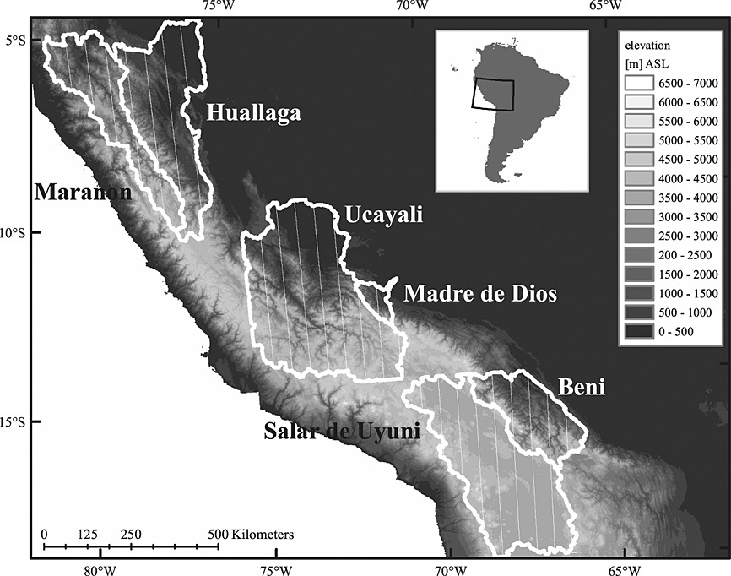
Supplemental Information S5 | Map of Ucayali river basin in the Central Andes. Pucallpa is marked with an arrow at (8.4° S, 74.6° W) coordinates. This map is adapted from Figure 1 Lowman and Barros (2014).

