Slide 1
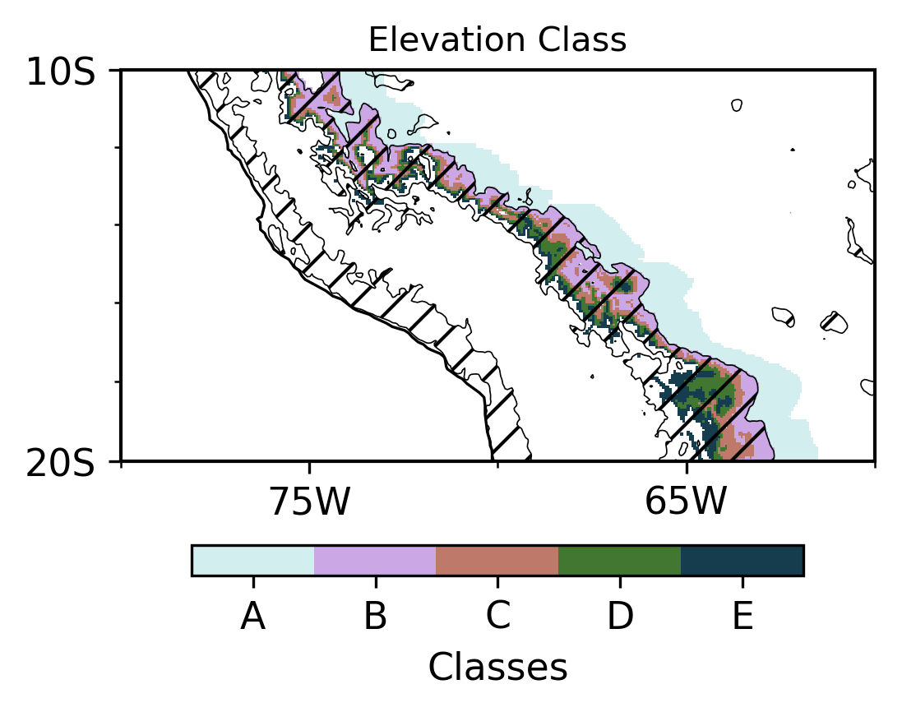
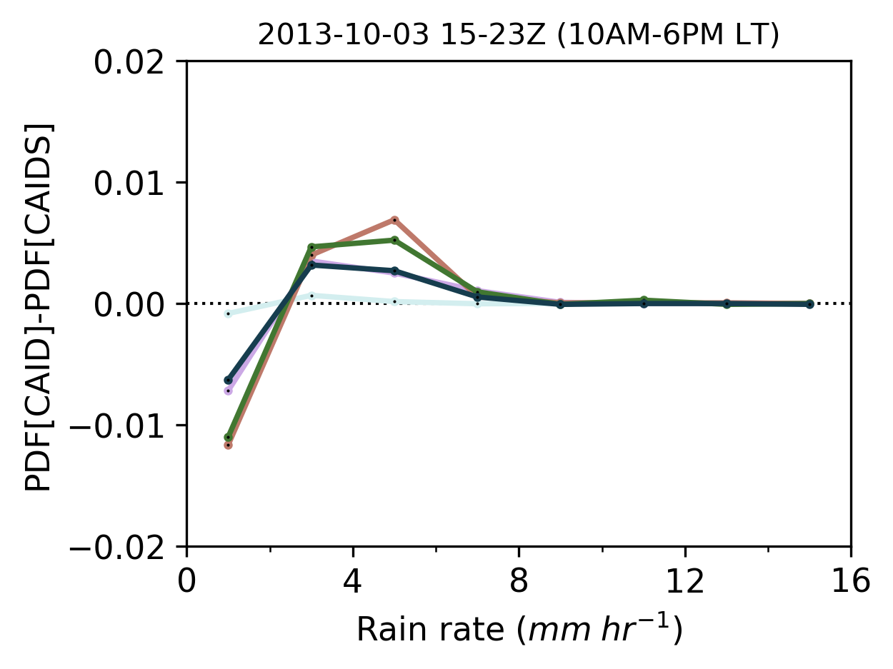
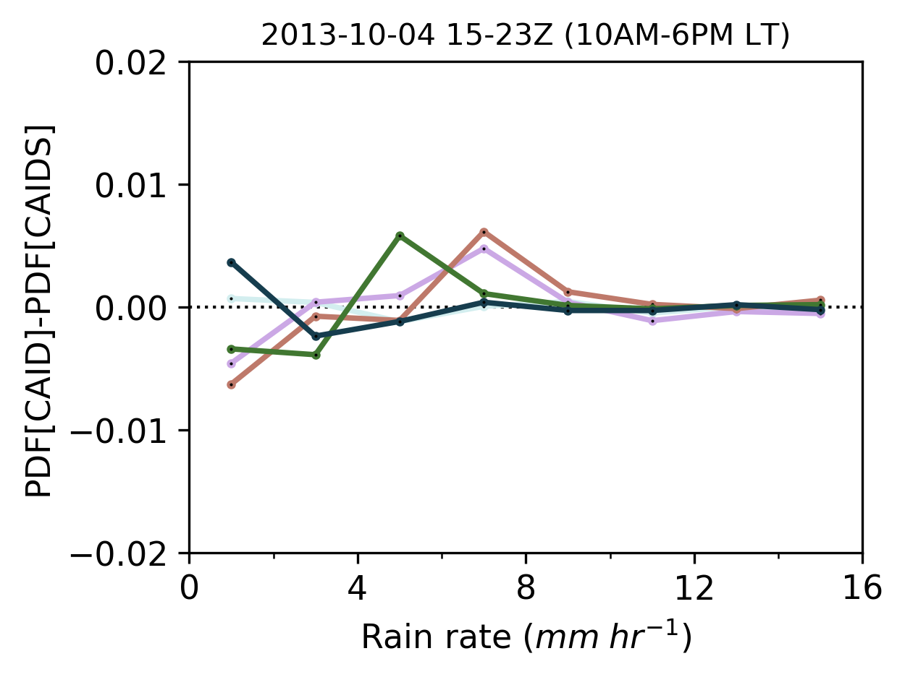
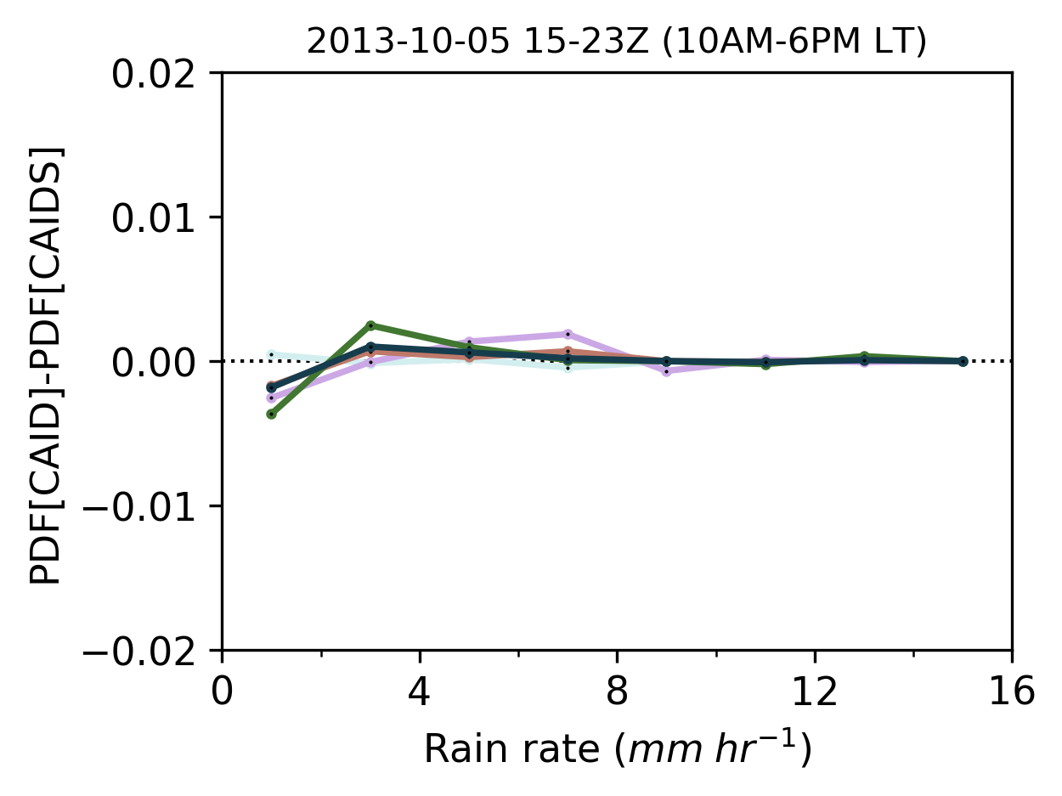
A
B
C
D
Supplemental Information S4 | Map of (A) elevation classes, where A corresponds to the 120 km through the east of the 500 m elevation contour, B, C, D, and D correspond to 500-1000 m, 1000-1500 m, 1500-2000 m, and 2000-2500 m, respectively. Difference in distribution of rain rate between the control and the modified simulation from the WRF simulation (D02, 6 km) classified by elevation and 10-20S latitudes for CAID case (B-D). The values for each distribution are for daytime between 15Z to 23Z corresponding to 10 AM to 6 PM local time.

