Slide 1
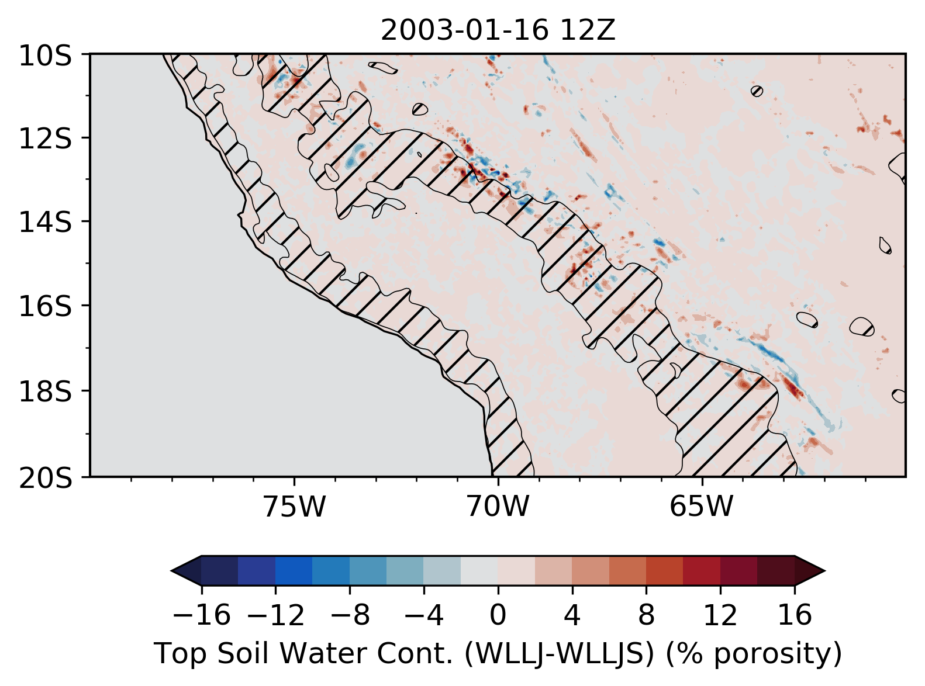
Supplemental Information S3 | Map of difference in the top 40 cm soil moisture (top two layers) for (D02, 6 km) for WLLJ-WLLJS at the end of the simulation 2003-01-16 12Z.

Slide 2
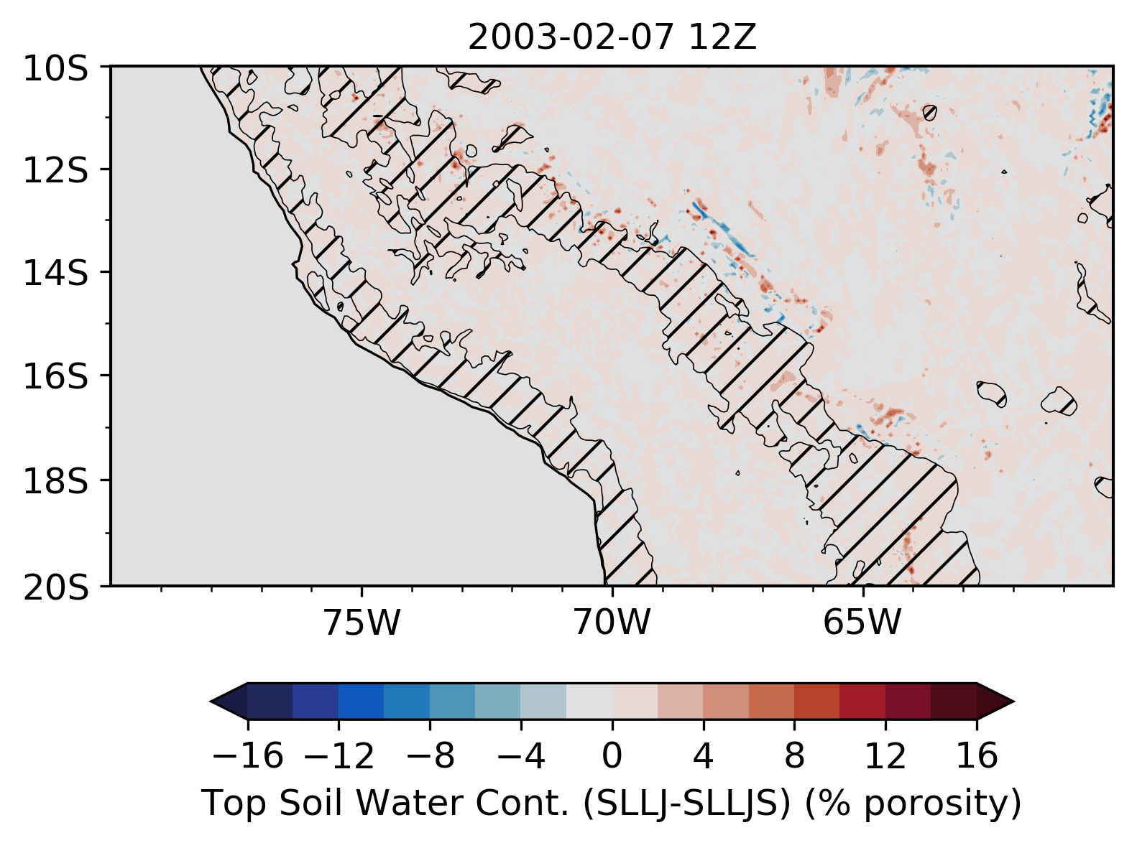
Supplemental Information S3 | Map of difference in the top 40 cm soil moisture (top two layers) for (D02, 6 km) for SLLJ-SLLJS at the end of the simulation 2003-02-07 12Z.

Slide 3
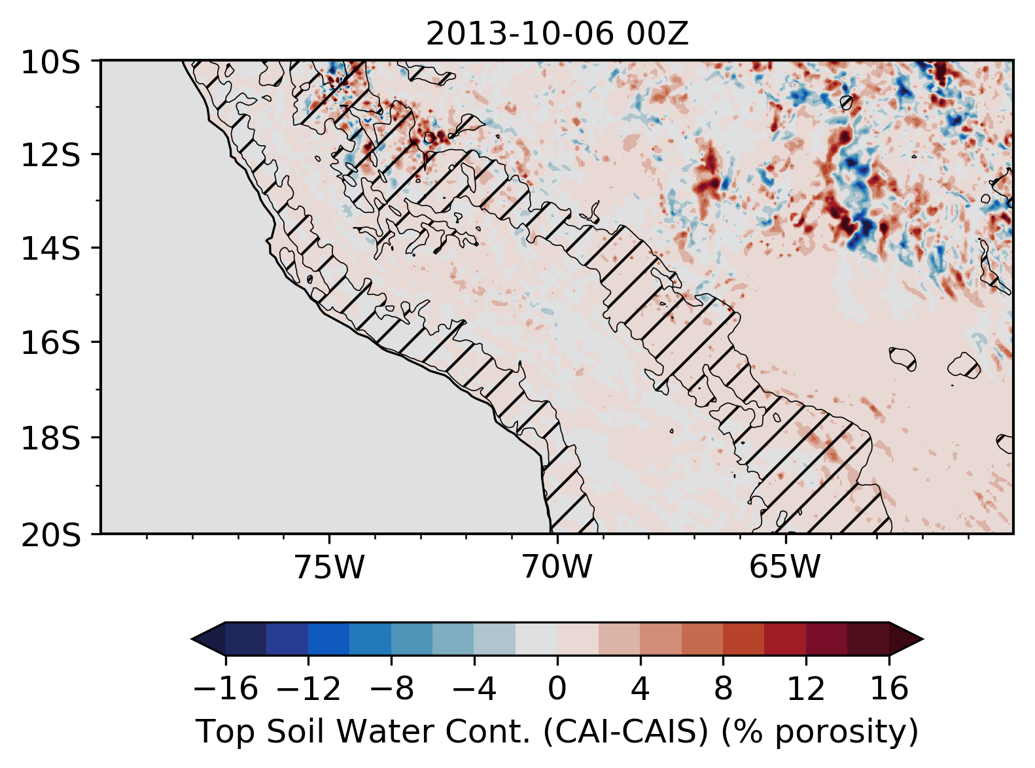
Supplemental Information S3 | Map of difference in the top 40 cm soil moisture (top two layers) for (D02, 6 km) for CAI-CAIS at the end of the simulation 2013-10-06 00Z.

