Slide 1
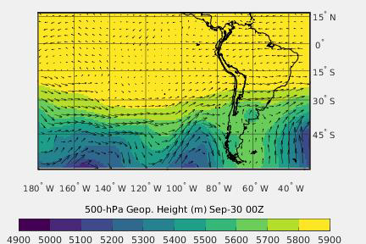
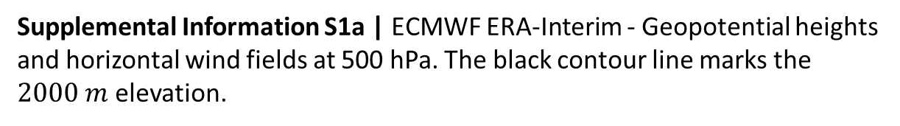
Supplemental Information S1a | ECMWF ERA-Interim - Geopotential heights and horizontal wind fields at 500 hPa. The black contour line marks the $2000 m$ elevation.

Slide 2
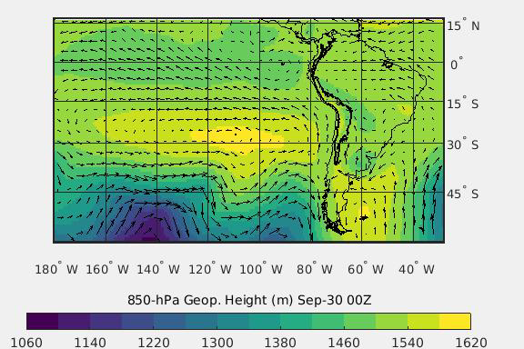
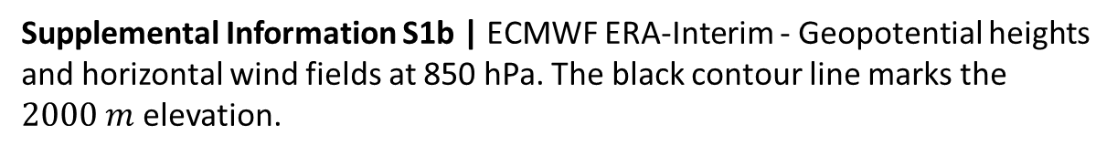
Supplemental Information S1b | ECMWF ERA-Interim - Geopotential heights and horizontal wind fields at 850 hPa. The black contour line marks the $2000 m$ elevation.

Slide 3
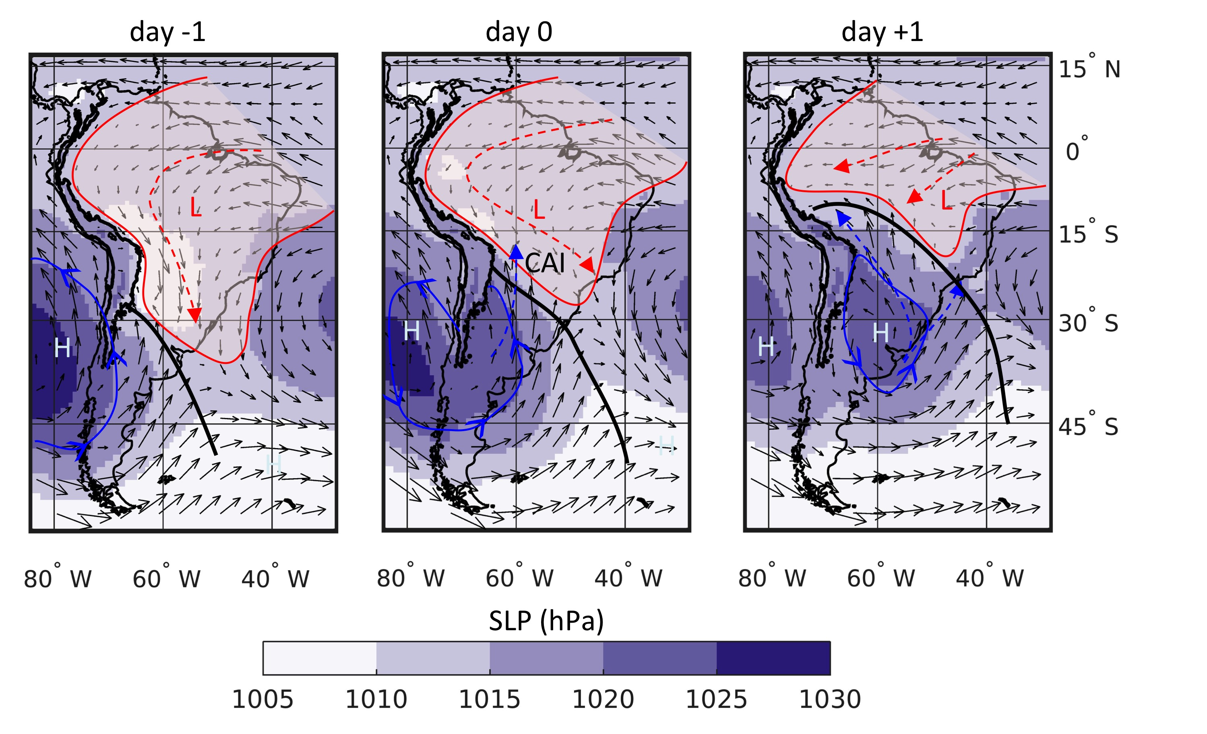
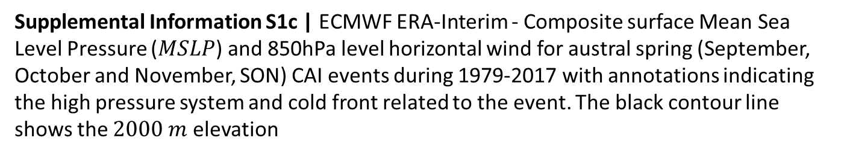
Supplemental Information S1c | ECMWF ERA-Interim - Composite surface Mean Sea Level Pressure ($MSLP$) and 850hPa level horizontal wind for austral spring (September, October and November, SON) CAI events during 1979-2017 with annotations indicating the high pressure system and cold front related to the event. The black contour line shows the $2000 m$ elevation

