Slide 1
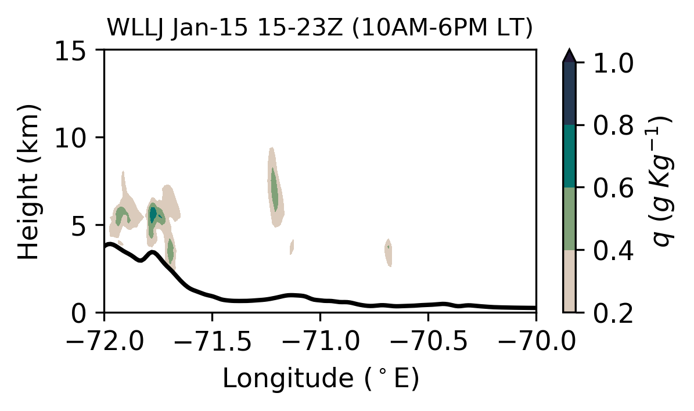
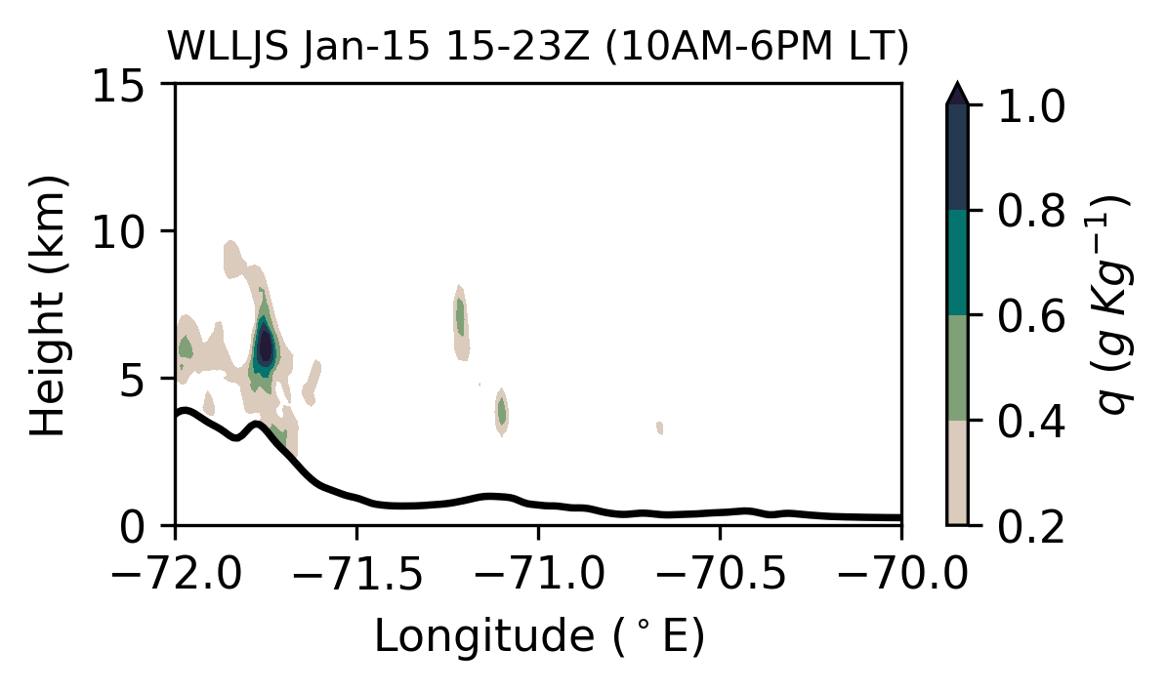
Supplemental Information S1 | Day-averaged cloud moisture (g kg⁻¹; cloud, ice, snow and graupel mixing ratio) of the cross section at 13.00 S for the control (CAI and WLLJ) and modified (CAIS and WLLJS) land-use cases. The black line shows the terrain contour. The values are from the high-resolution domain (D03, 1.2 km).

Slide 2
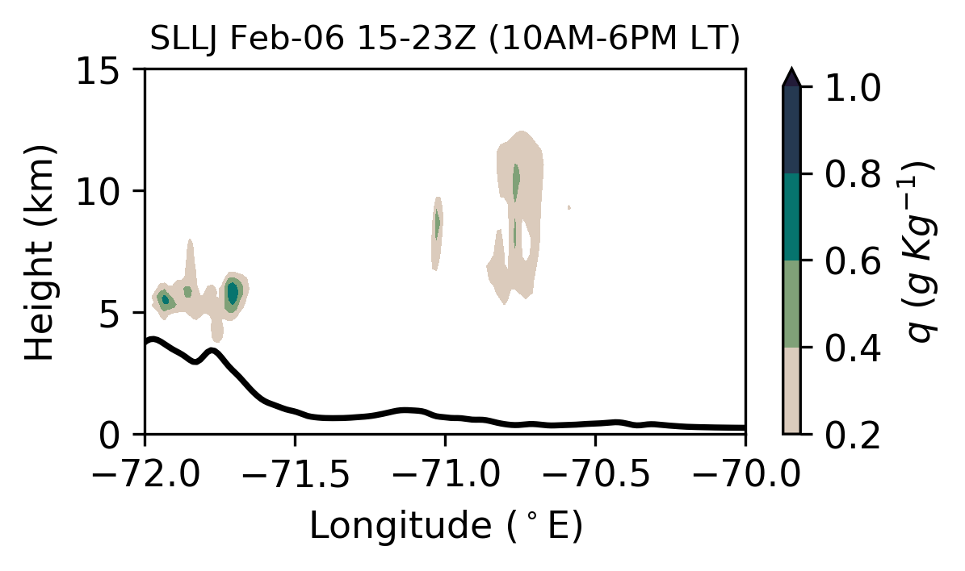
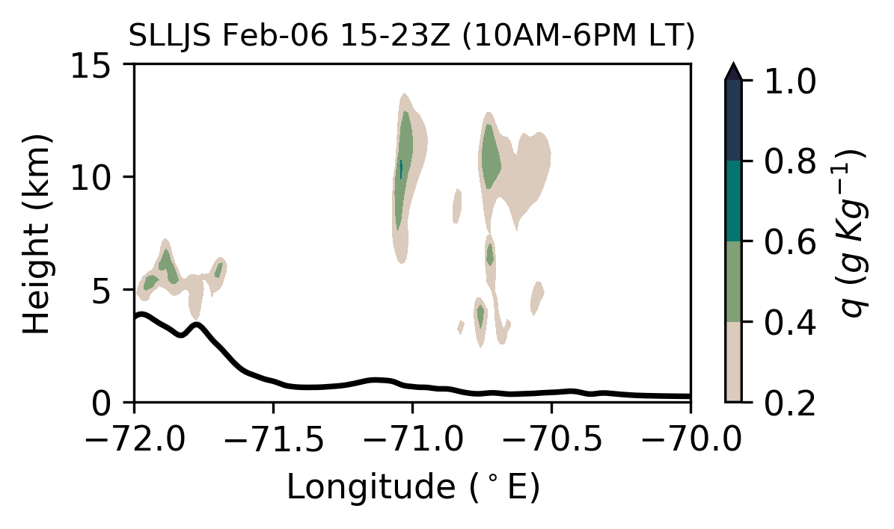
Supplemental Information S1 | (Continued)

Slide 3
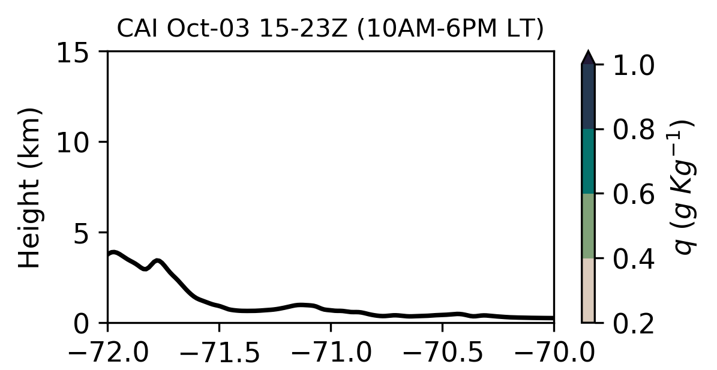
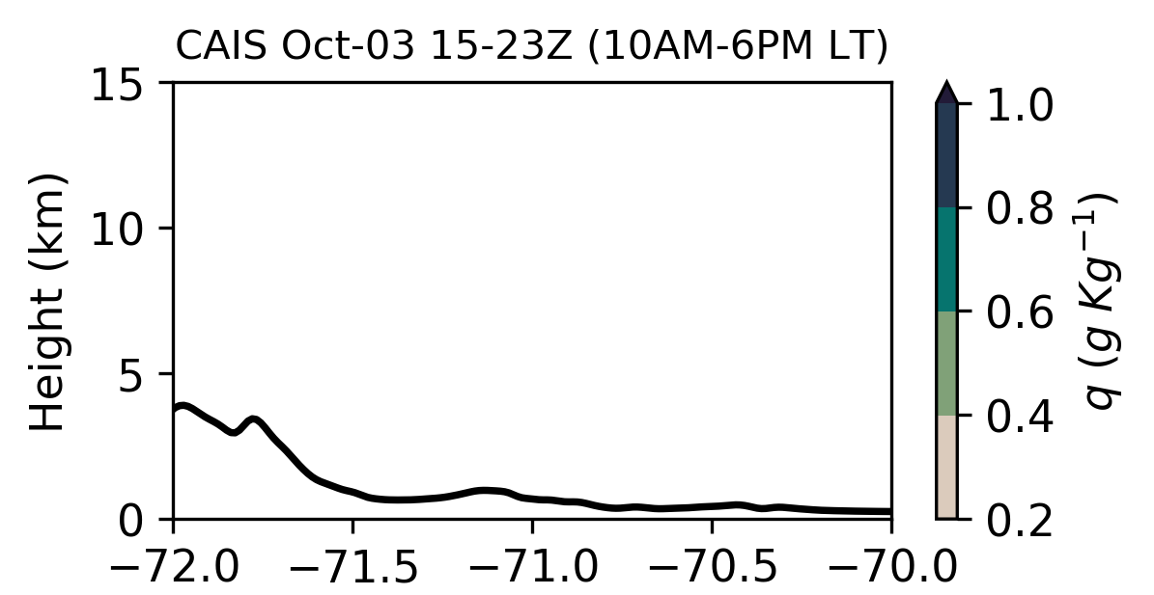
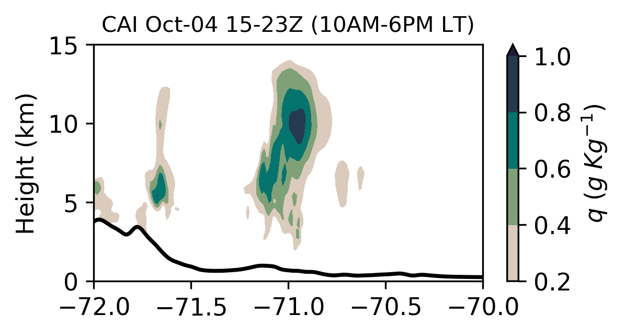
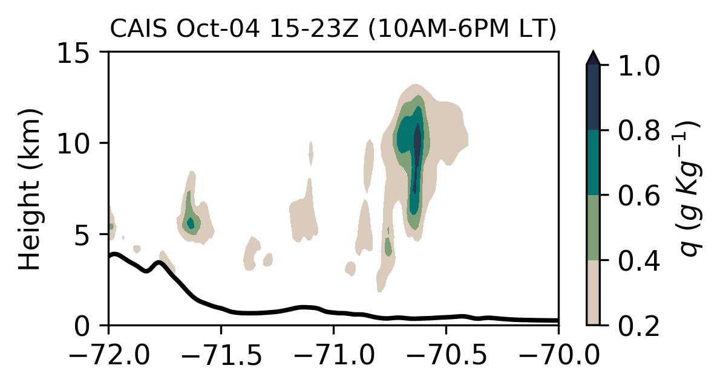
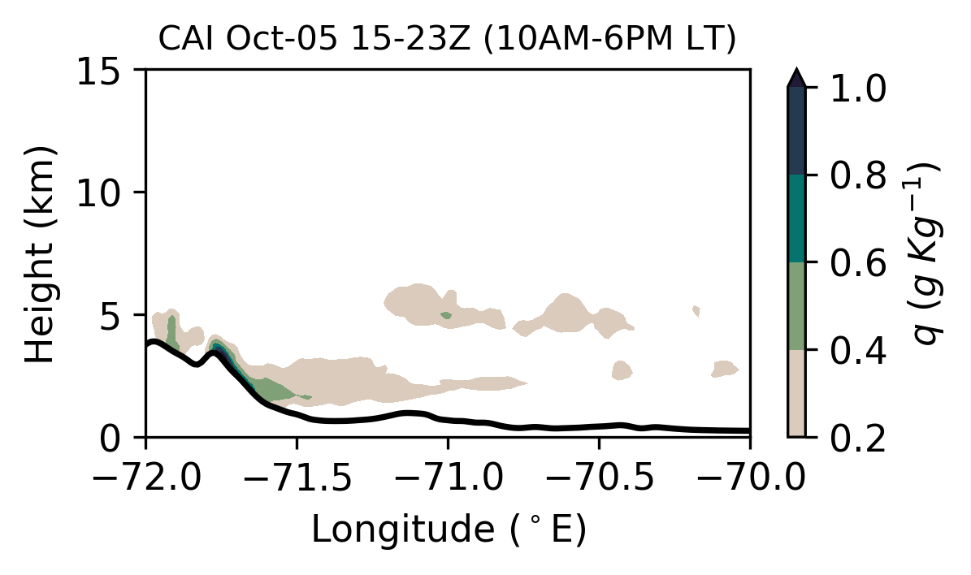
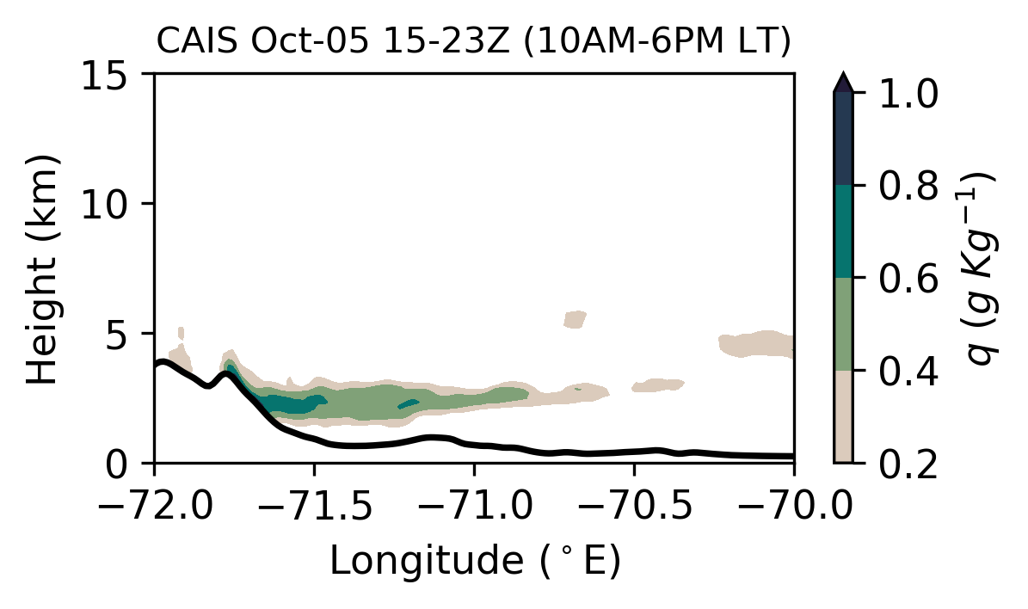
Supplemental Information S1 | (Continued)

