Slide 1
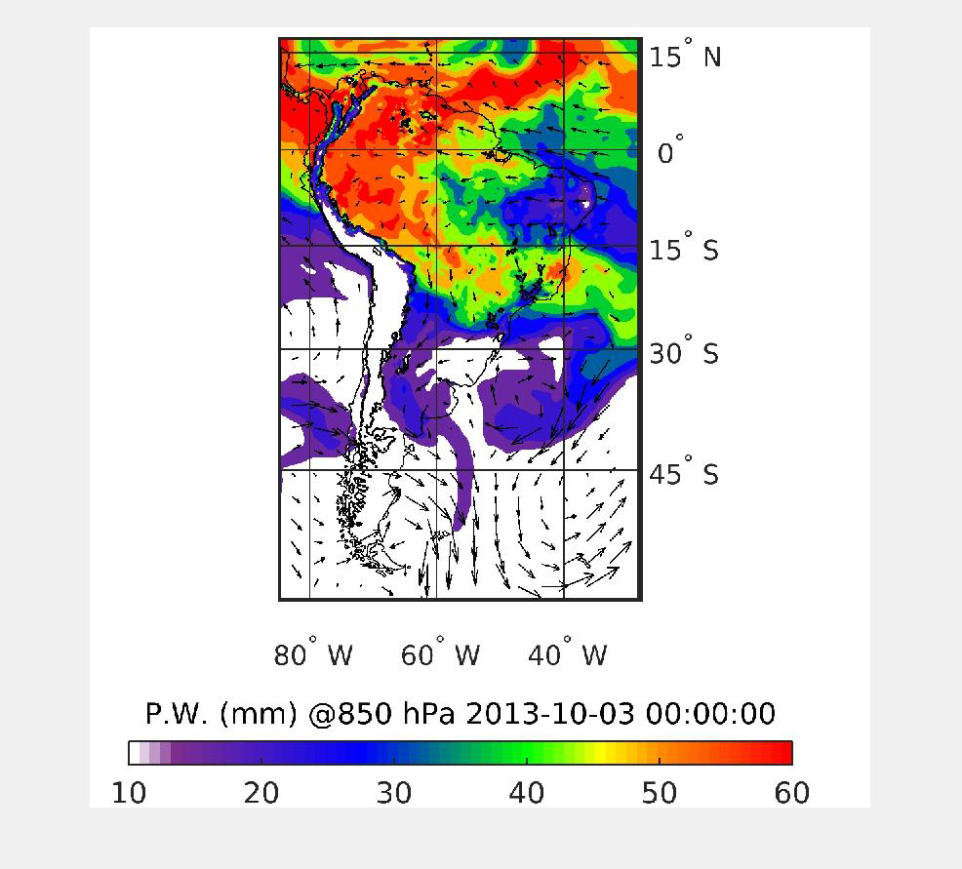
Supplemental Information S2 | Column Precipitable Water overlain on 850 hPa level horizontal wind fields.

