Slide 1
Supplementary Animated Figures
This Powerpoint contains supplementary animated figures that could not be included in the main text.

Slide 2
Description of the Figures
The following two slides show the symmetry averaged PBZ’s of INSD of Germanium and Niobium projected onto the measured reciprocal planes.
Center is the 3D energy momentum space. Left and right of the center plot are animations sweeping the energy momentum space along the different orthogonal reciprocal directions. Bottom is a sweep along the energy axis of the center plots.

Slide 3
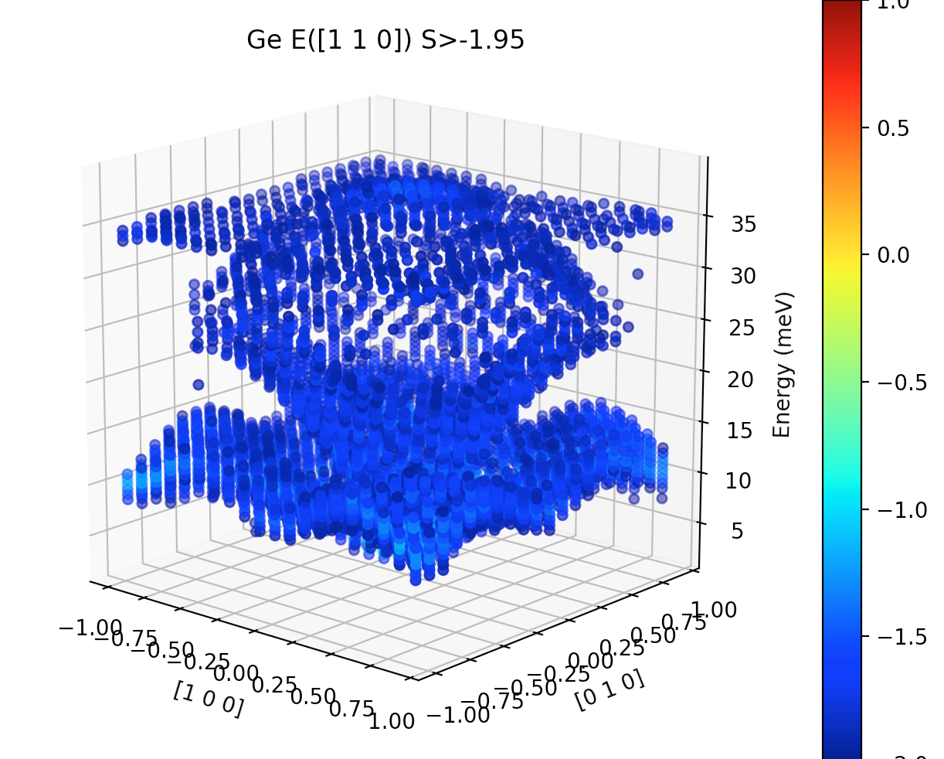
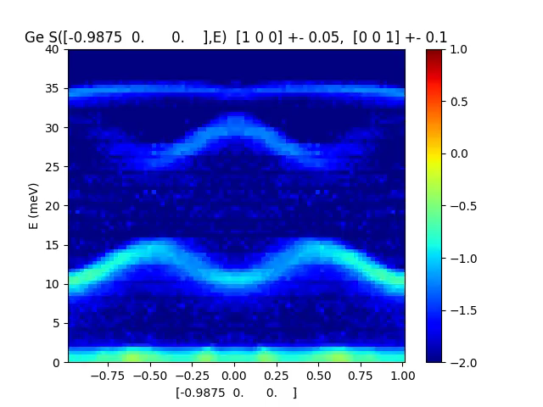
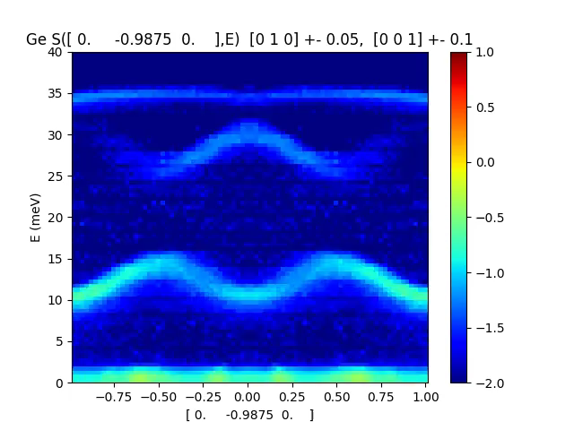
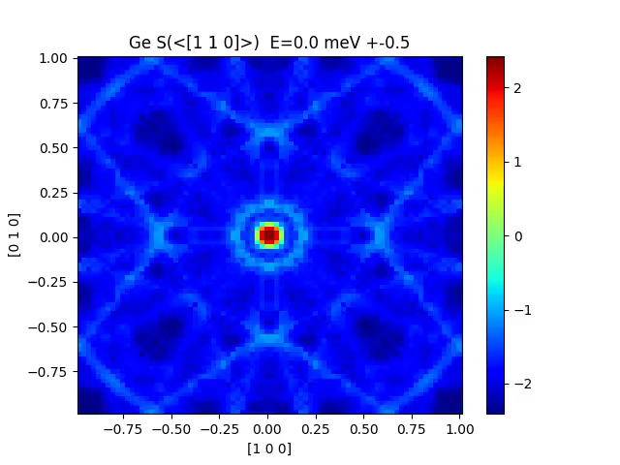

Ge S($q_{l},E$)

Slide 4
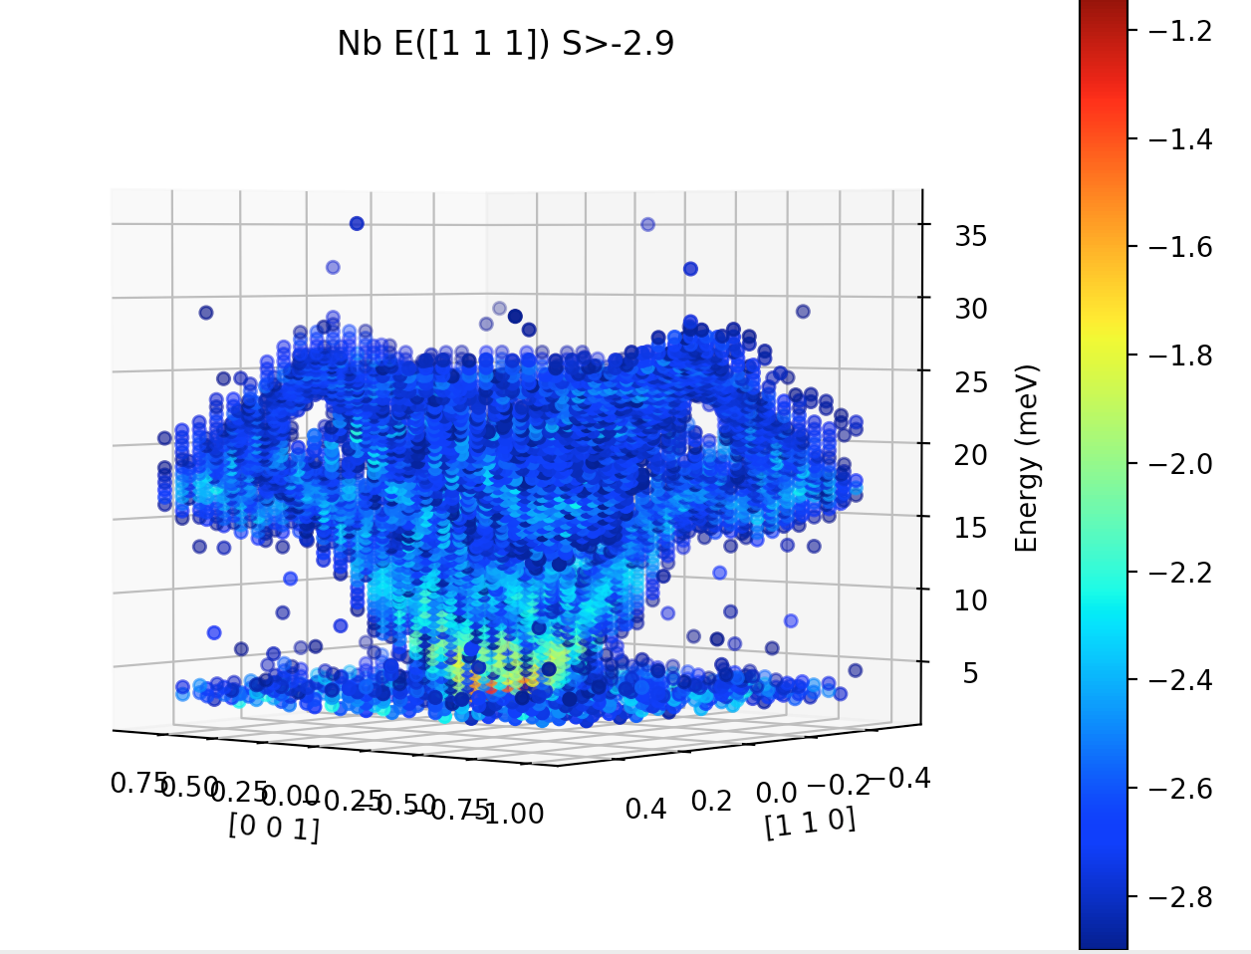
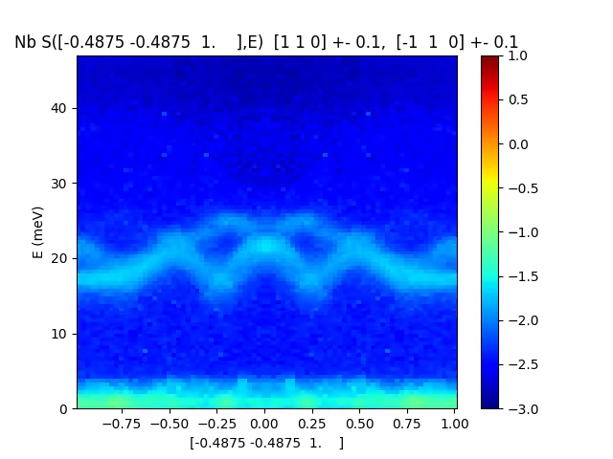
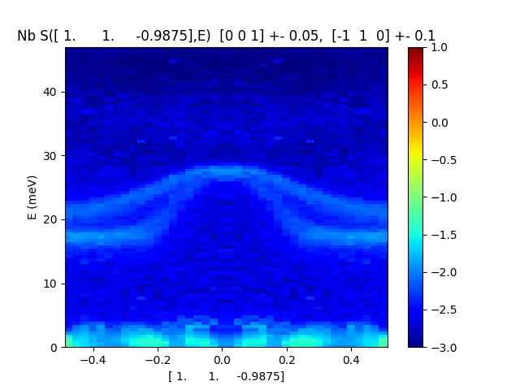
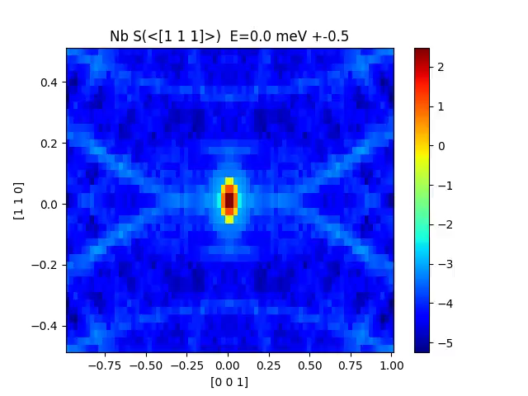

Nb S($q_{l},E$)

