Slide 1
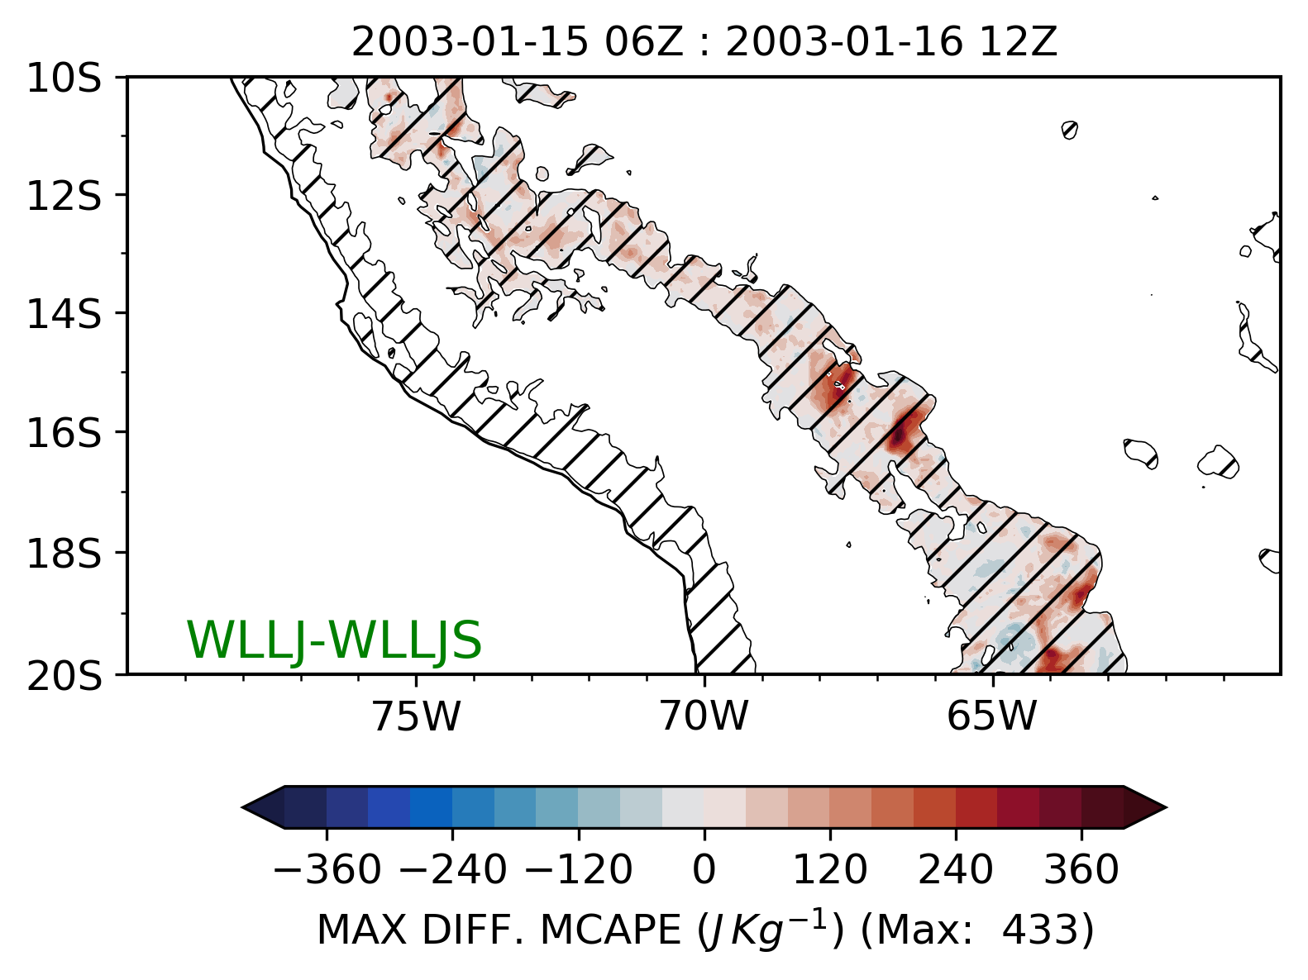
Supplemental Information S2 | Map of difference in the maximum MCAPE calculated every 10-minutes for (D02, 6 km) for WLLJ-WLLJS cases from 2003-01-15 06Z to 16 12Z.

Slide 2
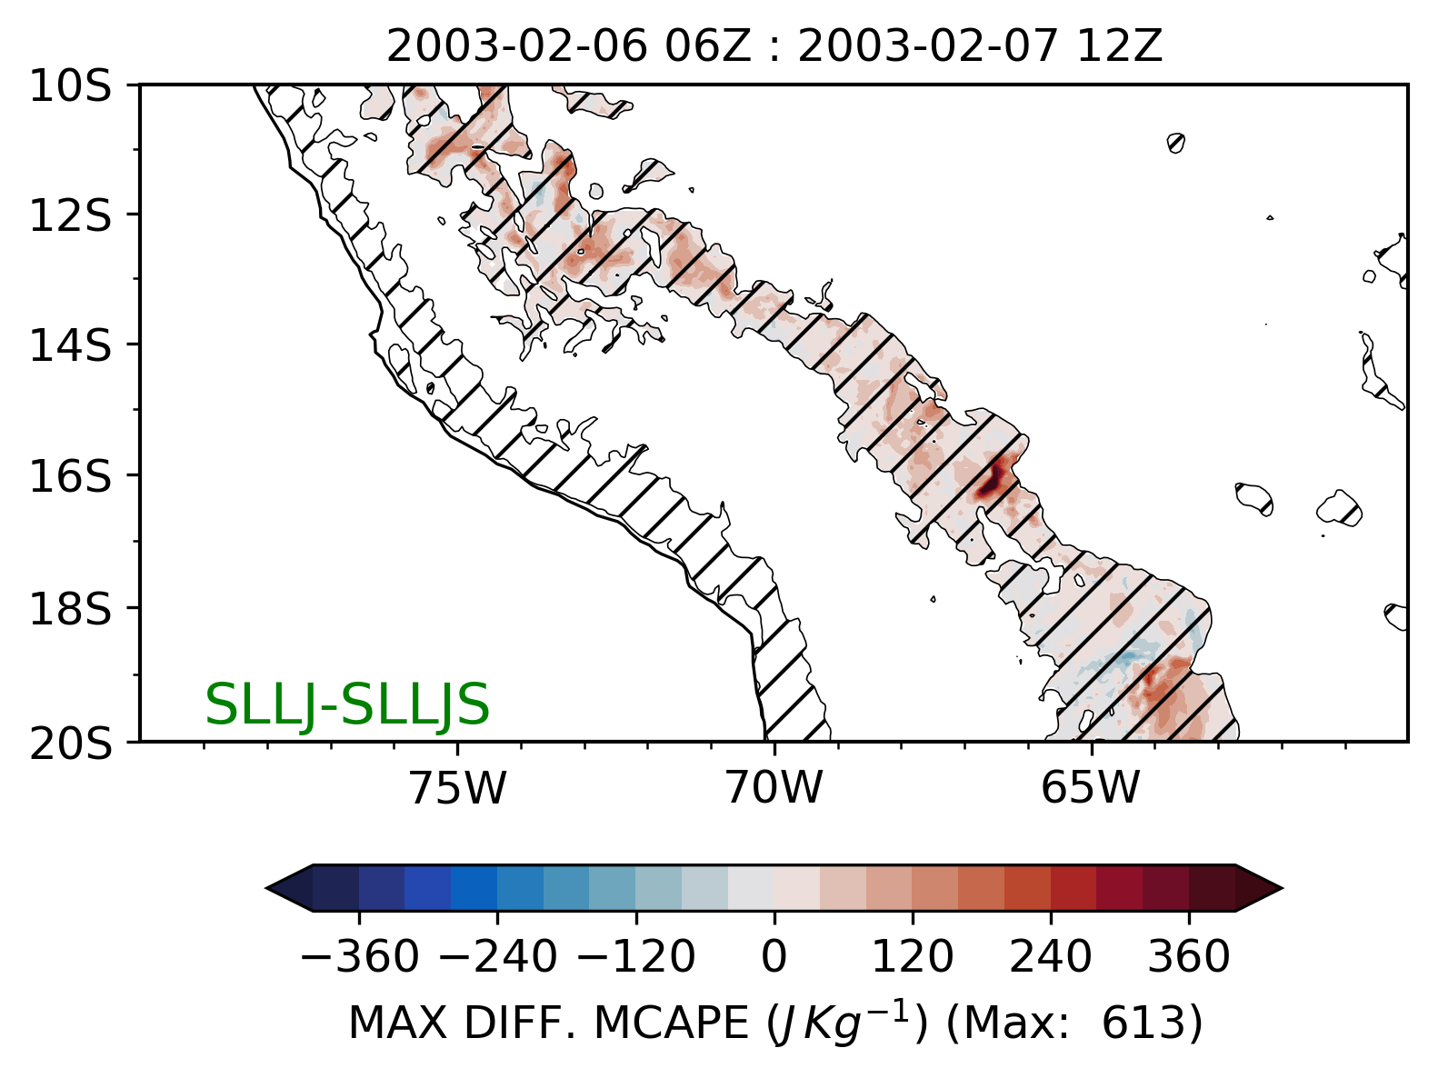
Supplemental Information S2 | Map of difference in the maximum MCAPE calculated every 10-minutes for (D02, 6 km) for SLLJ-SLLJS cases from 2003-02-06 06Z to 07 12Z.

Slide 3
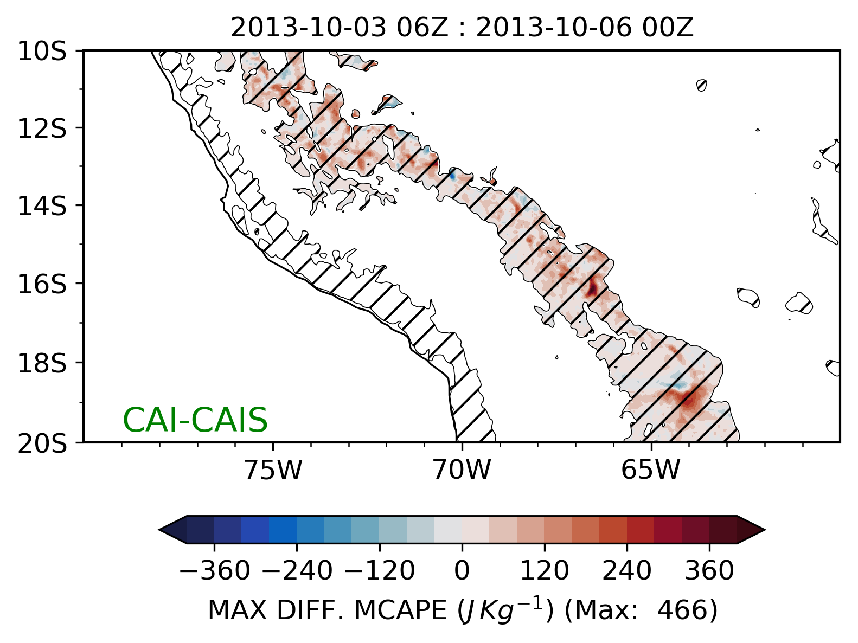
Supplemental Information S2 | Map of difference in the maximum MCAPE calculated every 10-minutes for (D02, 6 km) for CAI-CAIS cases from 2013-10-03 06Z to 06 00Z.

